Slide 1



Lesson 3: CSS (Part 1)
<Web />
Front-end
Development
University of Tehran
Lecturer:
Misagh Mohaghegh
ACM
Summer of Code 2024

Slide 2
A Short Review…
Hypertext Markup Language
Elements, opening and closing tags, content
Nested elements, void elements
Attributes, global attributes
Comments, XHTML
Page anatomy (html, head, body)
Metadata
Body
Semantic tags
Forms and inputs

Slide 3
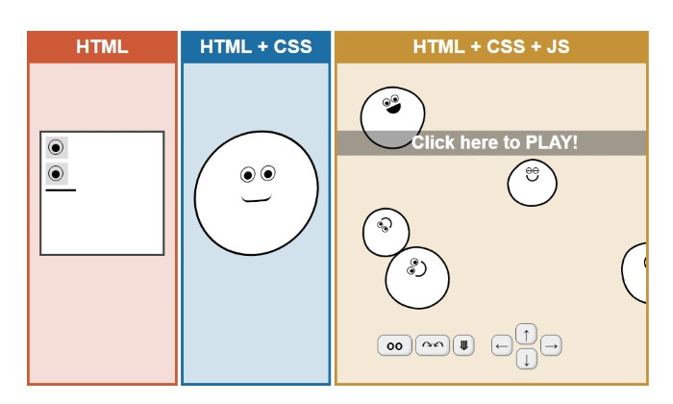
Time for…

Slide 4

Cascading Style Sheets

Slide 5
CSS & Selectors

Slide 6
Cascading Style Sheets
The primary tool to style web pages.
Cascading: Multiple styles can be applied to an element. Cascading rules choose which one overrides the others.
Style Sheets: A sheet that describes the styles of elements.
Version History: (W3C recommendation)
CSS 1 (1996): Fonts, colors, spacing, box model.
CSS 2 (1998): Positioning, media types, more properties.
CSS 2.1 (2011): Fixing most problems, add browser specific extensions.
CSS 3 (2012 - ...): Features are divided and modularized. Each module is standardized separately. This allows for faster development and browser implementation. Modules include Selectors, Backgrounds, Box Model, Color, Fonts, Flexbox, Grid Layout, Animations, Transformations and more.

Slide 7
Adding CSS
CSS rules are mostly written in a file.css and linked in the corresponding file.html. (External CSS)
<head>
<link rel="stylesheet" type="text/css" href="file.css">
</head>
<head>
<style>
/* CSS written here */
</style>
</head>
We can also write the CSS directly in the HTML file: (Internal CSS)
Or apply CSS directly to an element: (Inline CSS)
<p style="/* CSS written here */">Test</p>

Slide 8
CSS Rules
A CSS rule has the following structure:
Selector
Declaration
h1 {
color: red;
text-align: center;
}
Property
Value

Slide 9
Selectors
We have to first select an HTML element to apply styles to it.
There are many ways to select elements:
Simple selectors
Attribute selectors
Combinator selectors
Pseudo-class selectors
Pseudo-element selectors
Recall comments in HTML code:
<!-- This is a comment! -->
Comments in CSS code:
/* This is a comment! */

Slide 10
Simple Selectors
h1 { ... }
p { ... }
ul { ... }
img { ... }
<h1>Test</h1>
Tag selector:
#id { ... }
#my-image { ... }
<anytag id="id">Test</anytag>
<!-- The element with #id is selected (there is only one) -->
ID selector:
.class { ... }
.bottom-text { ... }
<anytag class="class">Test</anytag>
<!-- All elements that have this class are selected -->
Class selector:

Slide 11
Simple Selectors
Universal selector:
* { ... }
<h1>Test</h1>
<p>All elements are selected</p>
In combination:
p#title.center { ... }
<p id="title" class="center">Test</p>
h1.main,
p {
...
}
<h1 class="main center">Test</h1>
<p>All p tags and h1 elements that have the "main" class get the same property values</p>
Grouping selector:

Slide 12
Attribute Selectors
Have attribute:
[type] { ... }
<input type="text">
In combination:
input.rev[type] { ... }
<input class="rev" type="email">
Attribute value:
[type="url"] { ... }
<input type="url">
Space separated:
[title~="Web"] { ... }
<abbr title="World Wide Web">
Hyphen separated:
[class|="top"] { ... }
<p class="top-panel">Text</p>
Case insensitive:
[value="del" i] { ... }
<input type="button" value="DEL">

Slide 13
Attribute Selectors
Starts with:
[class^="left"] { ... }
<span class="leftmost">Test</span>
Ends with:
[class$="gap"] { ... }
<span class="rightgap">Test</span>
Contains:
[class*="desc"] { ... }
<span class="description">Test</span>

Slide 14
Combinator Selectors
Descendant:
nav.content p { ... }
<nav class="content">
<p>This element is selected</p>
<div>
<p>And so is this</p>
</div>
</nav>
Child selector:
main>h1 { ... }
<main>
<h1>This element is selected</h1>
<div>
<h1>Not selected</h1>
</div>
<h1>Also selected</h1>
</nav>

Slide 15
Combinator Selectors
Adjacent Sibling:
article#post+p { ... }
<article id="post">
<p>Not selected</p>
</article>
<h2>Heading</h2>
<p>This is selected</p>
<p>Not selected</p>
General Sibling:
article#post~p { ... }
<article id="post">
<p>Not selected</p>
</article>
<h2>Heading</h2>
<p>This is selected</p>
<p>Selected as well</p>

Slide 16
Selectors
We explored the first 3 main element selection categories:
Simple selectors (tag, id, class, universal, group, and their combination)
Attribute selectors (by attribute name and value using exact and containing matching)
Combinator selectors (descendant, direct children, adjacent and general siblings)
Pseudo-class selectors
Pseudo-element selectors
Pseudo-class and pseudo-elements will be explained later!

Slide 17
Color Properties

Slide 18
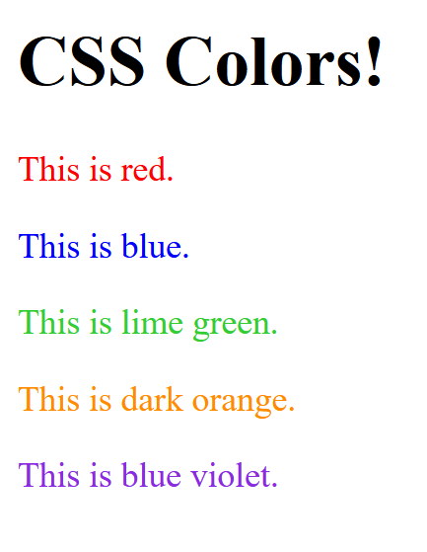
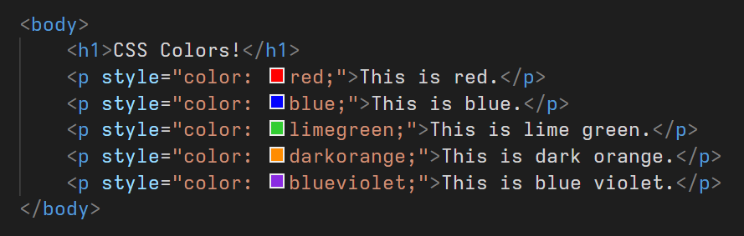
Colors
The first CSS property that we saw was the text color property.
The color property value can be a:
Color name
RGB (Red Green Blue) value
Hex (Hexadecimal) value
HSL (Hue Saturation Lightness) value
There are more than 150 standard color names supported by CSS.
(Inline CSS is used here)

Slide 19
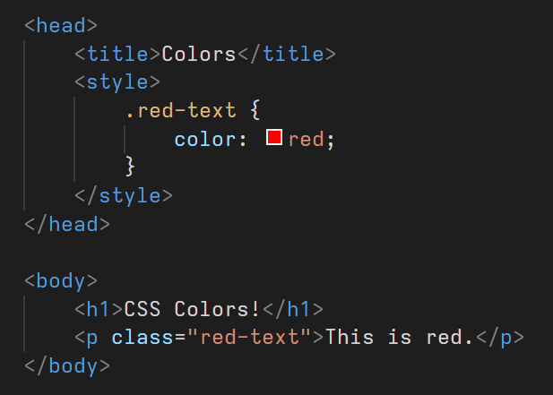
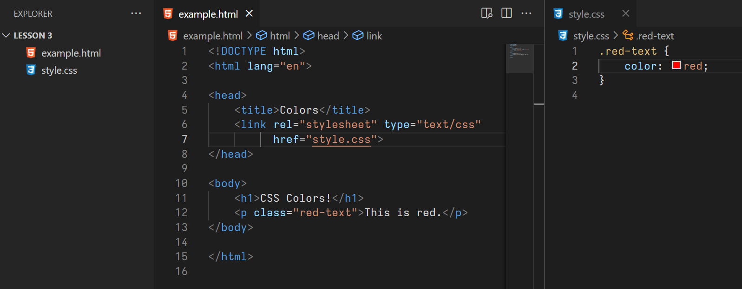
Colors
(Internal CSS)
(External CSS)

Slide 20
RGB
RGB color is made of 3 numbers in the range of 0 to 255: red, green, and blue.
color: rgb(255 0 0);
color: rgb(255 255 0);
color: rgb(0 255 0);
color: rgb(0 255 255);
color: rgb(0 0 255);
color: rgb(255 0 255);
color: rgb(0 0 0);
color: rgb(200 200 200);
color: rgb(255 255 255);
color: rgb(40 40 40);
color: rgb(128 128 128);
color: rgb(52 154 250);

Slide 21
RGB
The values can also be written using percentages.
color: rgb(100% 0 0);
color: rgb(50% 180 0);
The old way of writing used to have commas:
color: rgb(52, 154, 250);
The rgba keyword is the same as rgb.
color: rgba(52 154 250);

Slide 22
Alpha
There can be a forth value indicating the color's opacity, also known as the alpha value.
The value is between 0 and 1 (or 0% and 100%).
The default value is 1 (the color is fully opaque).
A value of 0 makes the color completely transparent and invisible.
color: rgb(255 0 0 / 1);
color: rgb(255 0 0 / 0);
color: rgb(255 0 0 / .5);
color: transparent;
color: rgb(255 0 0 / 20%);
In the old way of writing, a forth comma was used:
color: rgb(52, 154, 250, 1);

Slide 23
Hex
Another way of writing RGB colors is to use a hex value.
Hex values are a way of encoding numbers using the following table:
0 | 1 | 2 | 3 | 4 | 5 | 6 | 7 | 8 | 9 | 10 | 11 | 12 | 13 | 14 | 15
0 | 1 | 2 | 3 | 4 | 5 | 6 | 7 | 8 | 9 | A | B | C | D | E | F
Decimal system: 42 = 4x10 + 2 = 42
Hexadecimal system: 42 = 4x16 + 2 = 66,
4A = 4x16 + A = 64 + 10 = 74
The highest 2 digit hex number is FF which is equal to: Fx16 + F = 15x16 + 15 = 255
So each RGB value can be represented using a 2 digit hex value.

Slide 24
Hex
The RGB values are written as: #RRGGBB
color: rgb(255 0 0);
color: #ff0000;
color: rgb(0 255 0);
color: #00ff00;
color: rgb(52 154 250);
color: #349afa;
color: rgb(0 0 0);
color: #000000;
color: rgb(255 255 255);
color: #ffffff;

Slide 25
Hex
RGBA values are written as: #RRGGBBAA
color: rgb(255 0 0 / .5);
color: #ff000080
We can use a shorthand if all RGB hex pairs are the same:
color: #ff0000
color: #f00

Slide 26
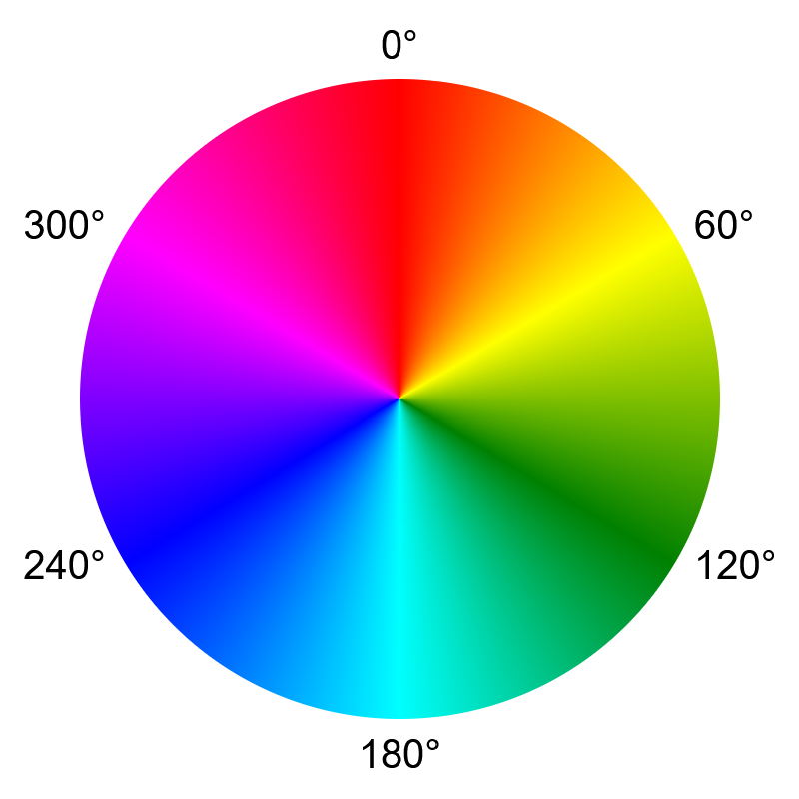
HSL
The HSL color model represents the same color space as RGB does (sRGB color space).
Hue: this is the actual color element between 0 and 360 (can optionally have the deg unit e.g. 360deg).
Saturation: a value between 0% and 100% representing the color's saturation.
Lightness: a value between 0% and 100% representing the color's brightness.
Just like RGB, an additional alpha parameter can also be present.
color: rgb(255 0 0);
color: hsl(0 100% 50%);
color: rgb(0 255 0);
color: hsl(120 100% 50%);
color: rgb(0 0 255);
color: hsl(240 100% 50%);
color: rgb(0 0 0);
color: hsl(0 0% 0%);
color: rgb(255 255 255);
color: hsl(0 0% 100%);

Slide 27
HSL
With alpha:
color: rgb(255 0 0 / .5);
color: hsl(0 100% 50% / .5);
color: rgb(52 154 250);
color: hsl(209 95% 59%);

Slide 28
HSL
Easily change the brightness or the saturation without changing the base color.
color: hsl(120 100% 80%);
color: rgb(0 255 0);
color: hsl(120 100% 50%);
color: hsl(120 100% 20%);
color: hsl(120 50% 50%);
color: rgb(102 153 102);
color: hsl(120 20% 50%);
color: hsl(120 0% 50%);

Slide 29
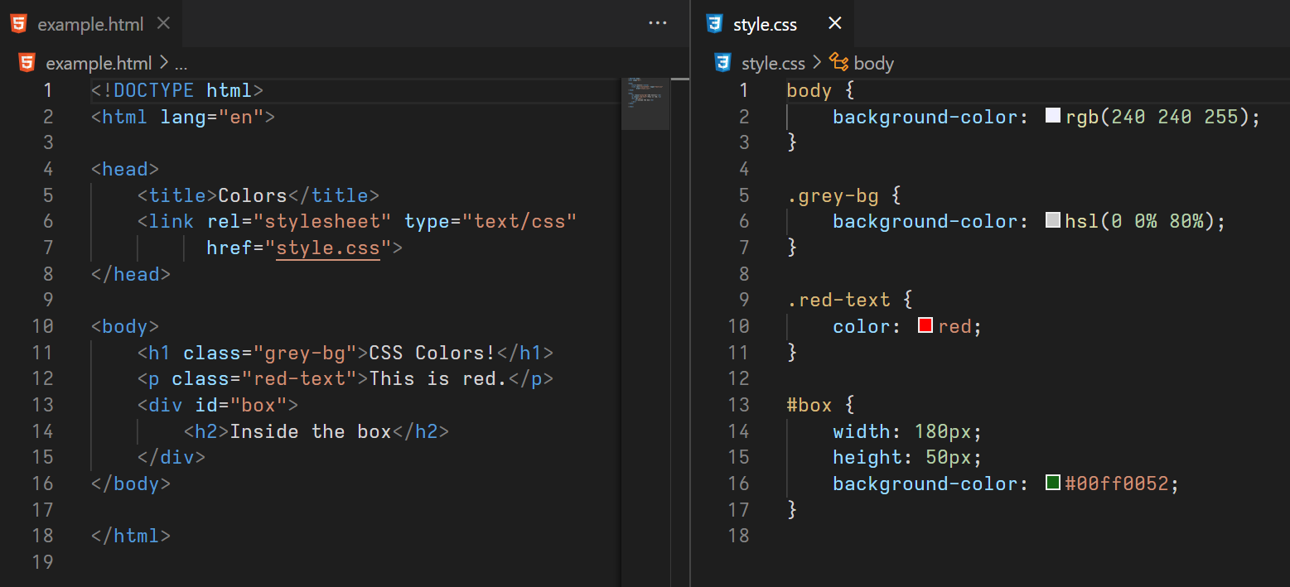
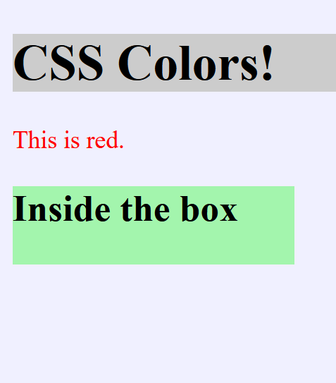
Background Color

Slide 30
Text Formatting Properties

Slide 31
Text Formatting
We have already seen the color property in detail.
The color property sets the text color, and the background-color property sets its background.
Here we are going to take a look at the following properties:
text-align
direction
text-decoration
text-transform
text-indent
letter-spacing
word-spacing
line-height
text-shadow
font-size
font-style
font-weight

Slide 32
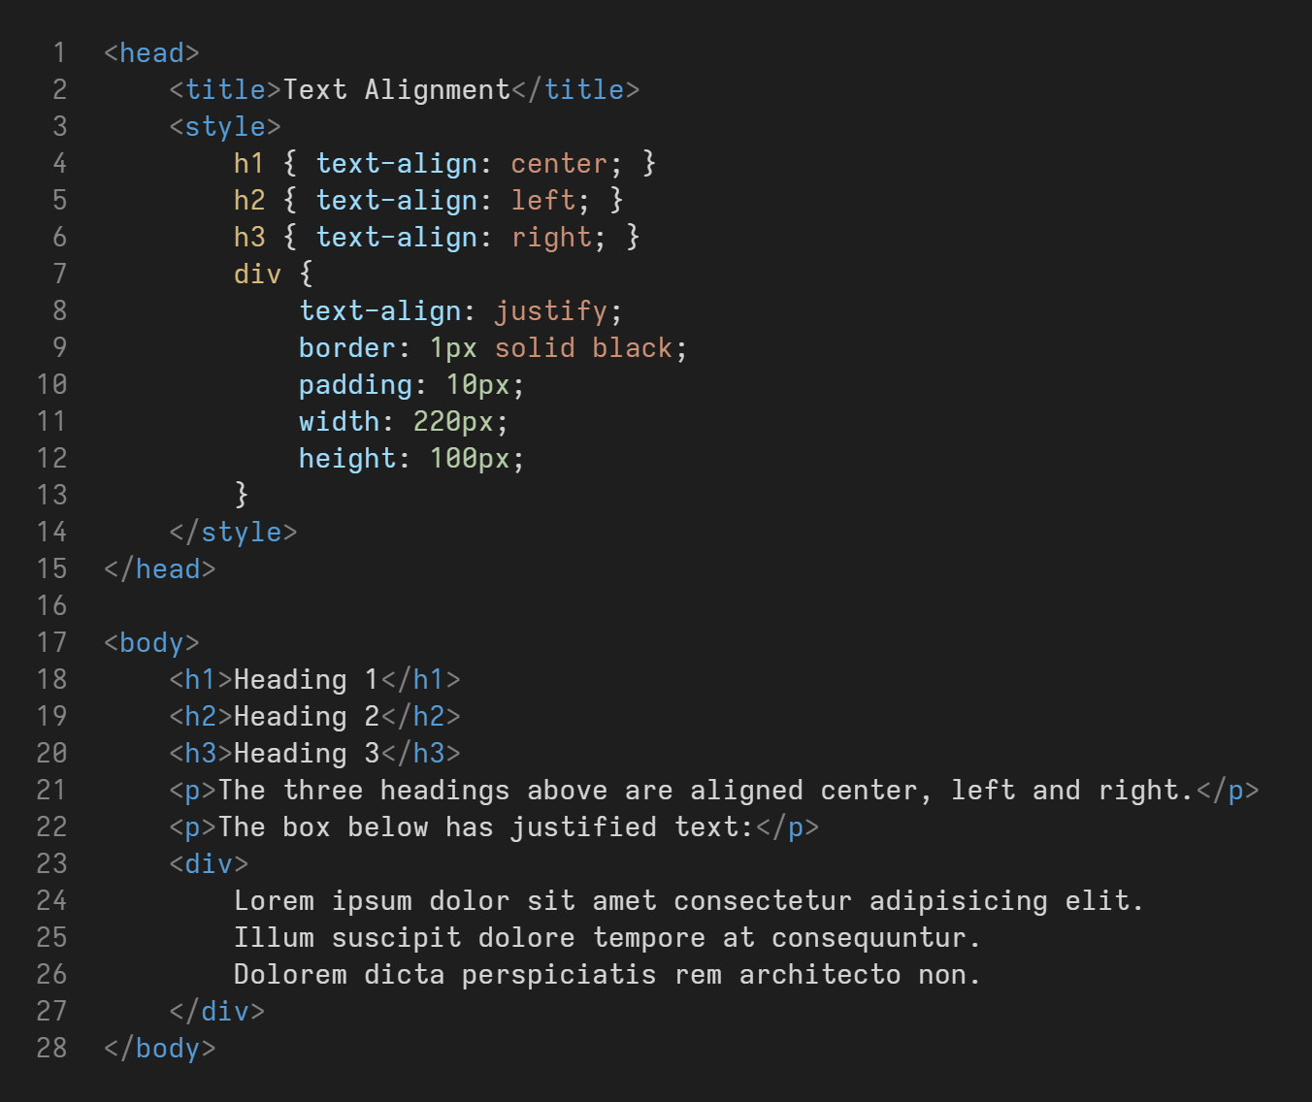
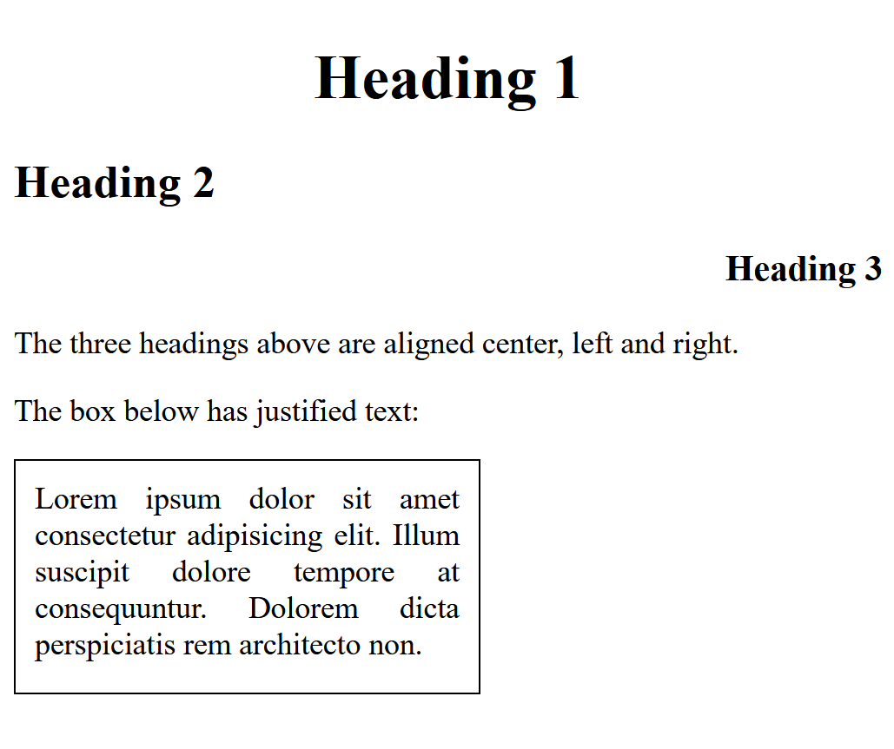
Text Alignment
The text-align property sets the horizontal alignment of text. (text-align-last aligns the last line of a text)
Valid values: left, right, center, justify.

Slide 33
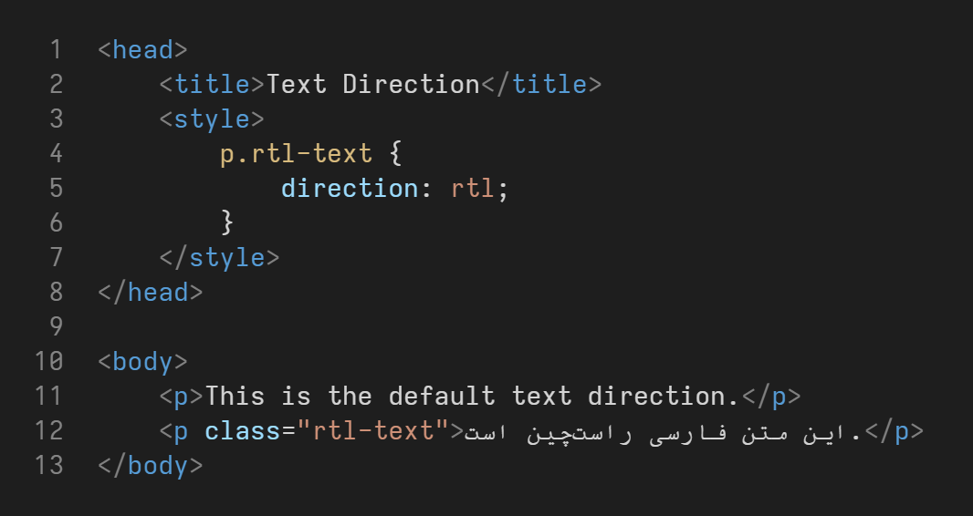
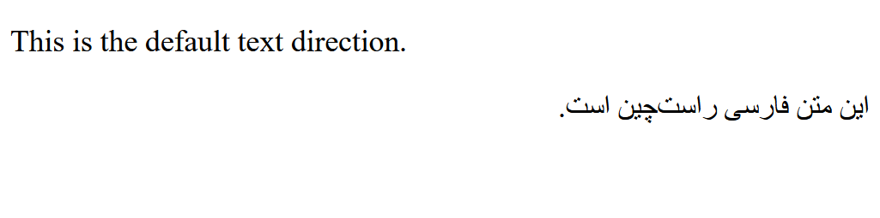
Text Direction
The direction property sets the text direction. Valid values: rtl, ltr.
This property should usually be avoided and the HTML dir attribute should be used instead.

Slide 34
Text Decoration
The text-decoration property allows setting different decorations such as underlines to text.
The property is a shorthand property, meaning that there are sub-properties that can be set separately, and the shorthand property allows setting them all in one property.
text-decoration = text-decoration-line text-decoration-color
text-decoration-style text-decoration-thickness
Valid decoration lines: none, overline, line-through, underline, or a list of them.
Valid decoration colors are any valid CSS colors.
Valid decoration styles: solid, double, dotted, dashed, wavy.
Valid decoration thickness is any valid CSS length unit (such as px).

Slide 35
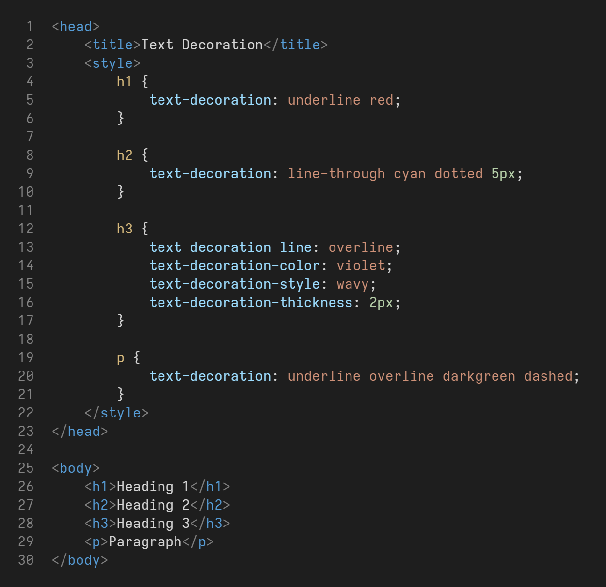
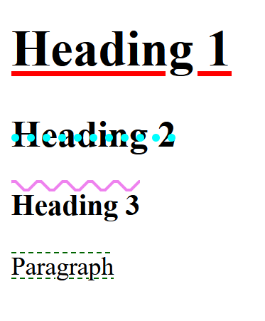
Text Decoration

Slide 36
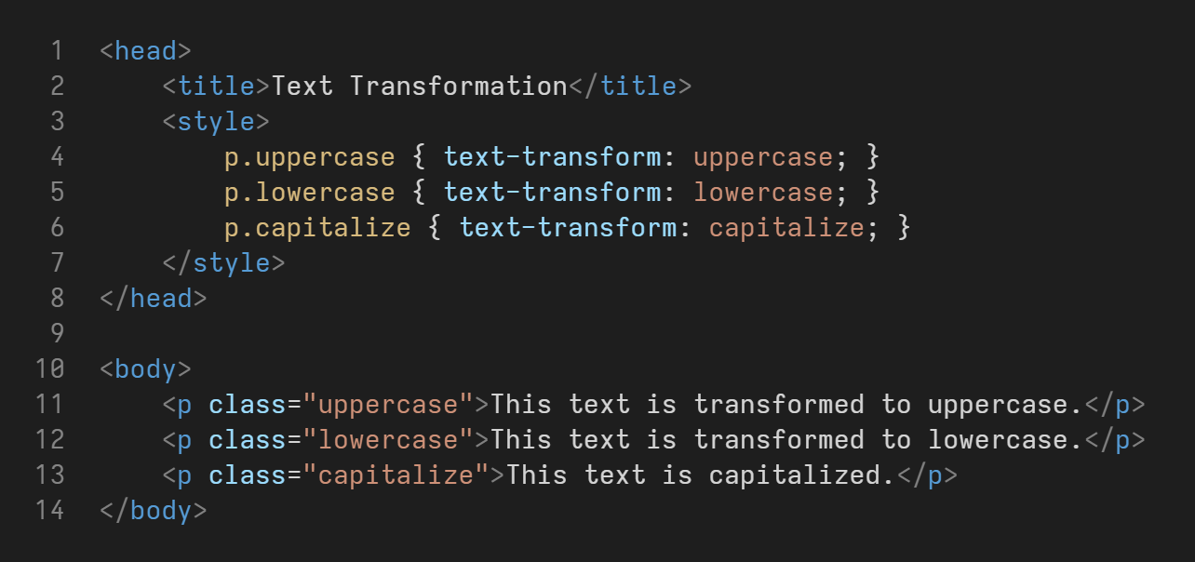
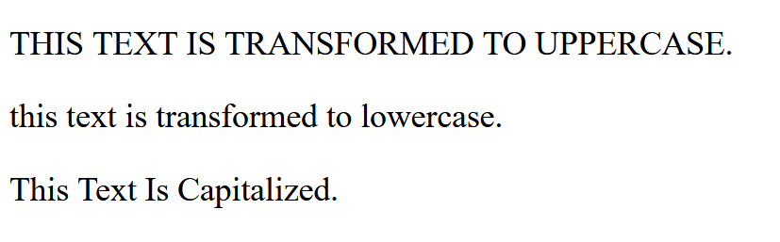
Text Transformation
The text-transform property controls the capitalization of text.
Valid values: uppercase, lowercase, capitalize.

Slide 37
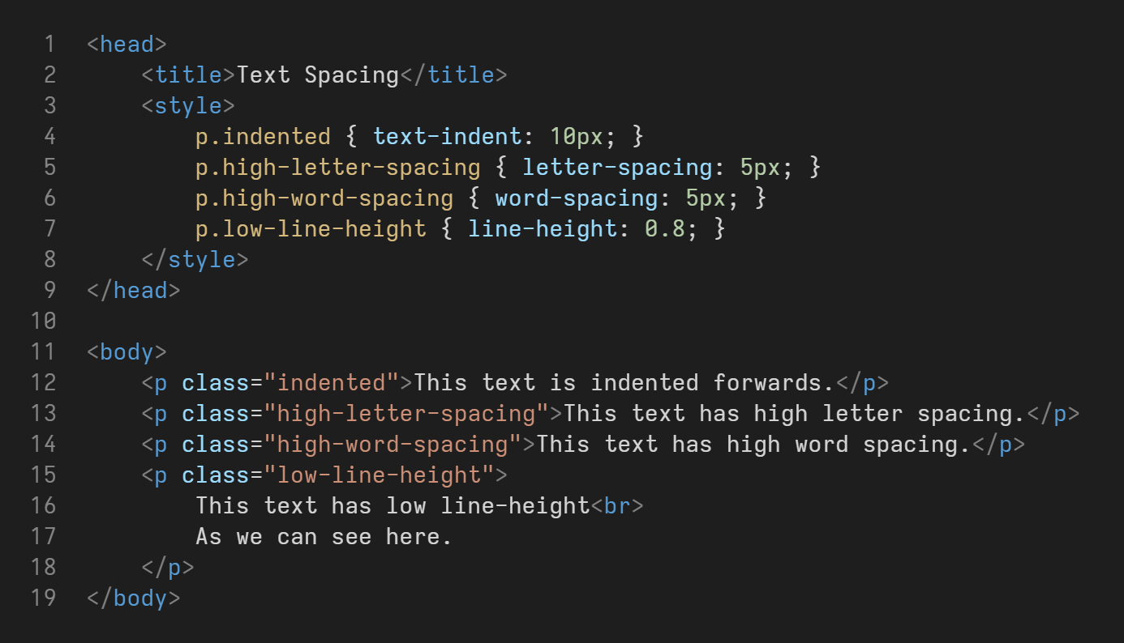
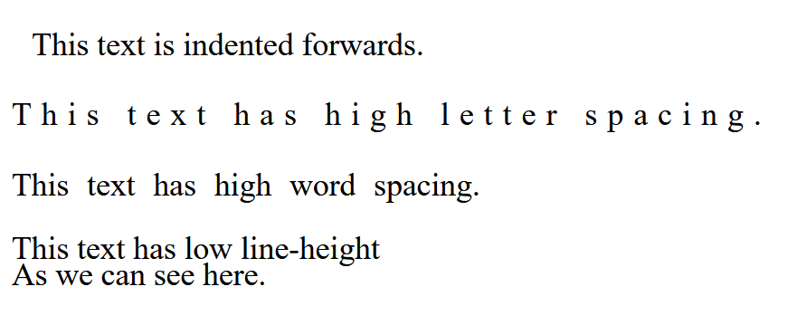
Text Spacing
The text-indent property specifies the indentation of the first line of a text.
The letter-spacing property specifies the space between the characters of a text.
The word-spacing property specifies the space between the words of a text.
The line-height property specifies the space between lines.

Slide 38
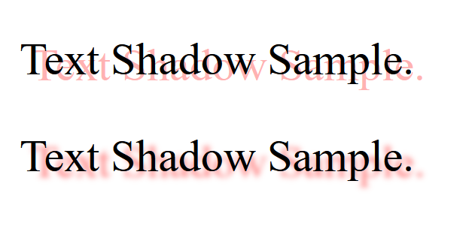
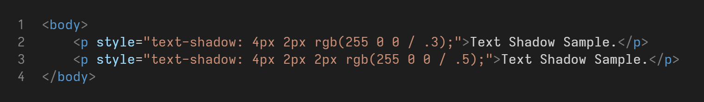
Text Shadow
The text-shadow property adds shadow to text.
text-shadow: horizontal-offset vertical-offset [optional]blur color

Slide 39
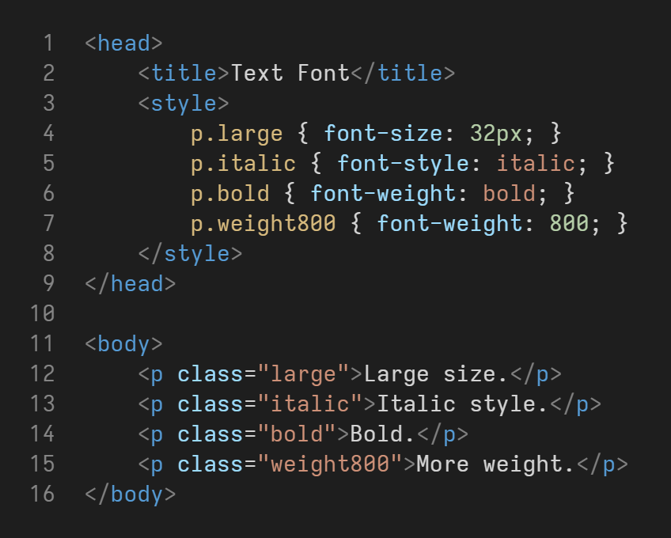
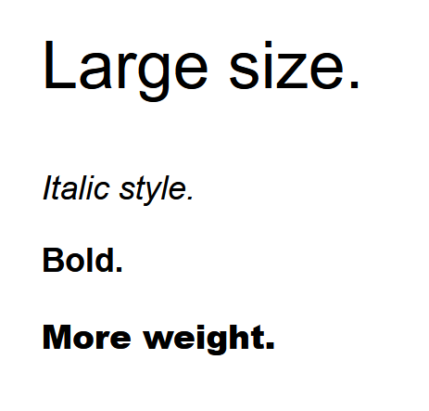
Font
The font-size property sets the font size (units such as px, em, rem, %, vw).
The font-style property can set the text to be italic.
The font-weight property sets the weight of the font (100-900). 400 is normal, 700 is bold.

Slide 40
Box Model

Slide 41
Outer Display Type
All HTML elements can be considered as boxes.
If a box has an outer display type of block (such as h1, p, div, …):
It will take its own new line.
width and height properties are respected.
Margin, padding and borders cause other elements to be pushed away from the box.
These are not the case with inline elements (such as span, a, strong, …).
The CSS display property can be used to set the outer and inner display type:
display: block;
display: inline;
So for example, div has display: block and span has display: inline as the default outer display type.
The inner display types are also these 2 based on the tag but can be set to other types such as flex and grid.

Slide 42
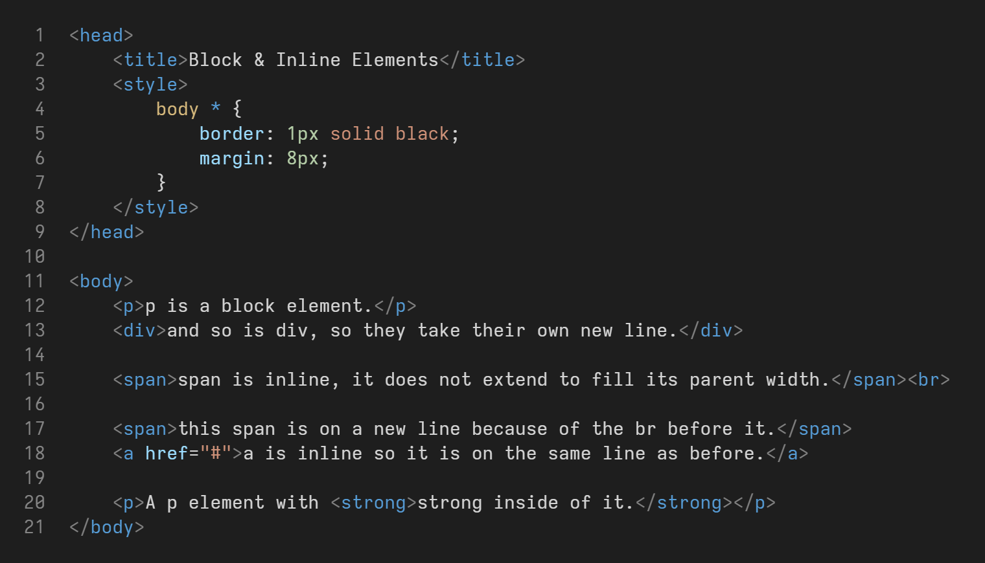
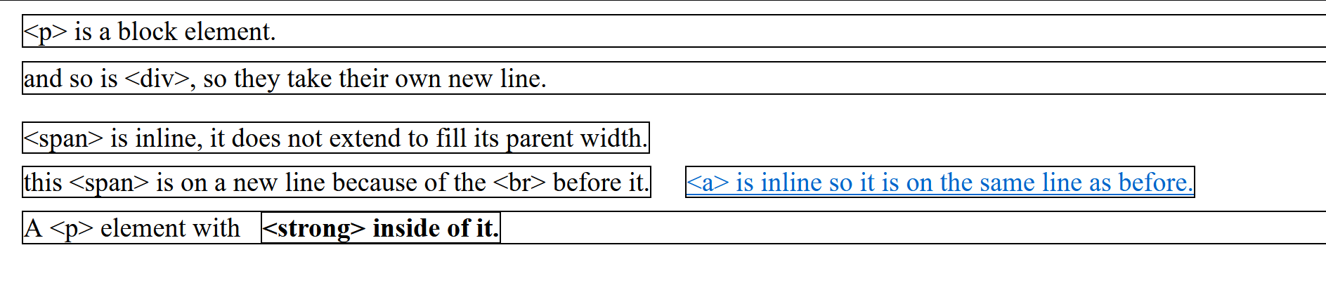
Outer Display Type

Slide 43
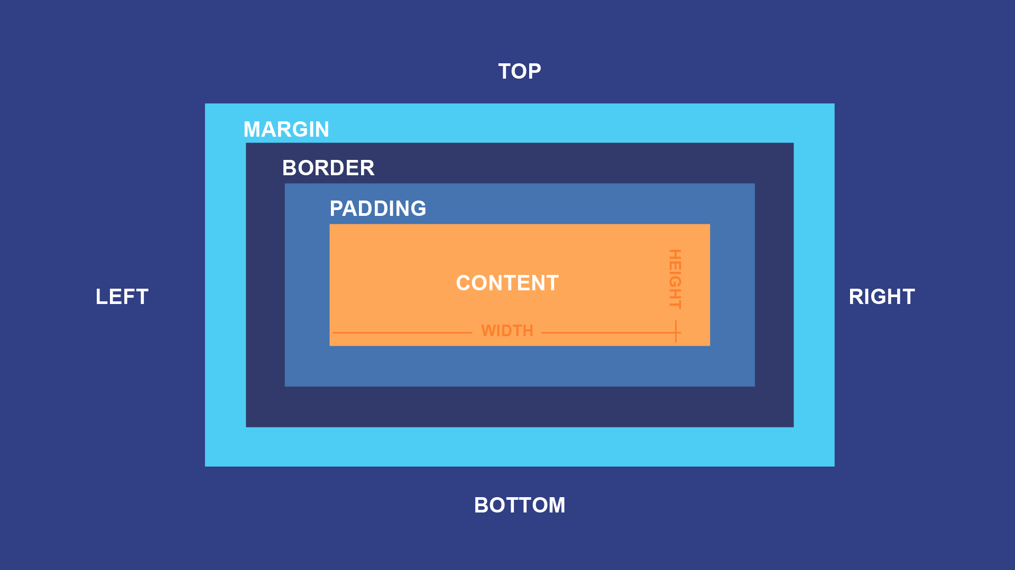
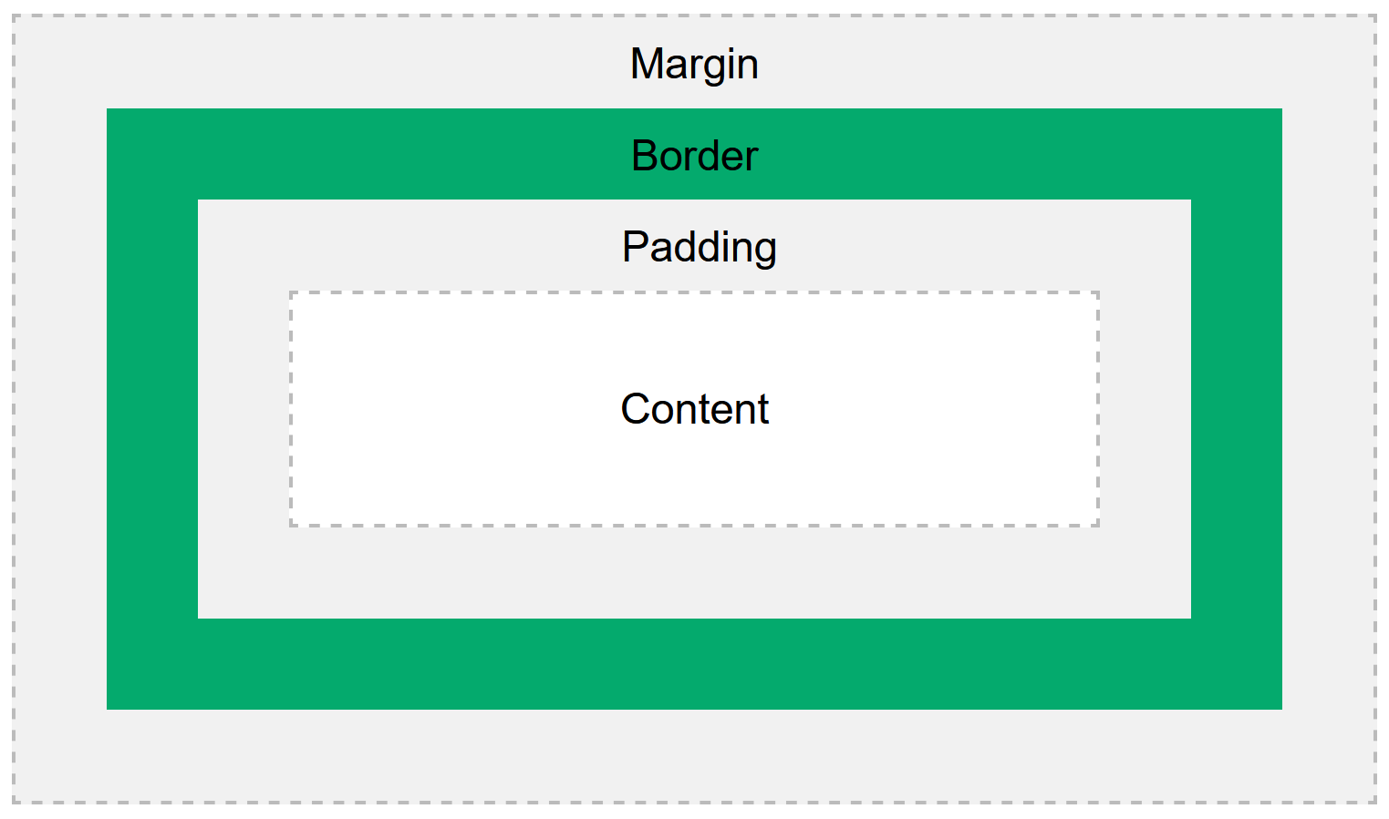
Box Model
The box model is used by block elements to define how margin, border, padding and content work together.
Content box: this is the content such as the text inside a <p> tag.
Padding box: padding sits around the content as white space.
Border box: the border wraps the padding and content.
Margin box: the margin wraps everything and is placed between other elements and our border.

Slide 44
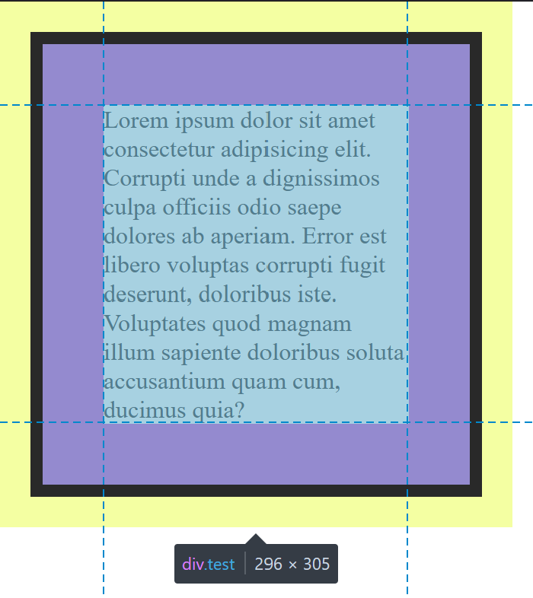
Box Model
We can see this more clearly in the browser developer tools.
(Right-click and Inspect)
Content box: blue and grid lines.
Padding box: purple.
Border box: black.
Margin box: yellow.

Slide 45
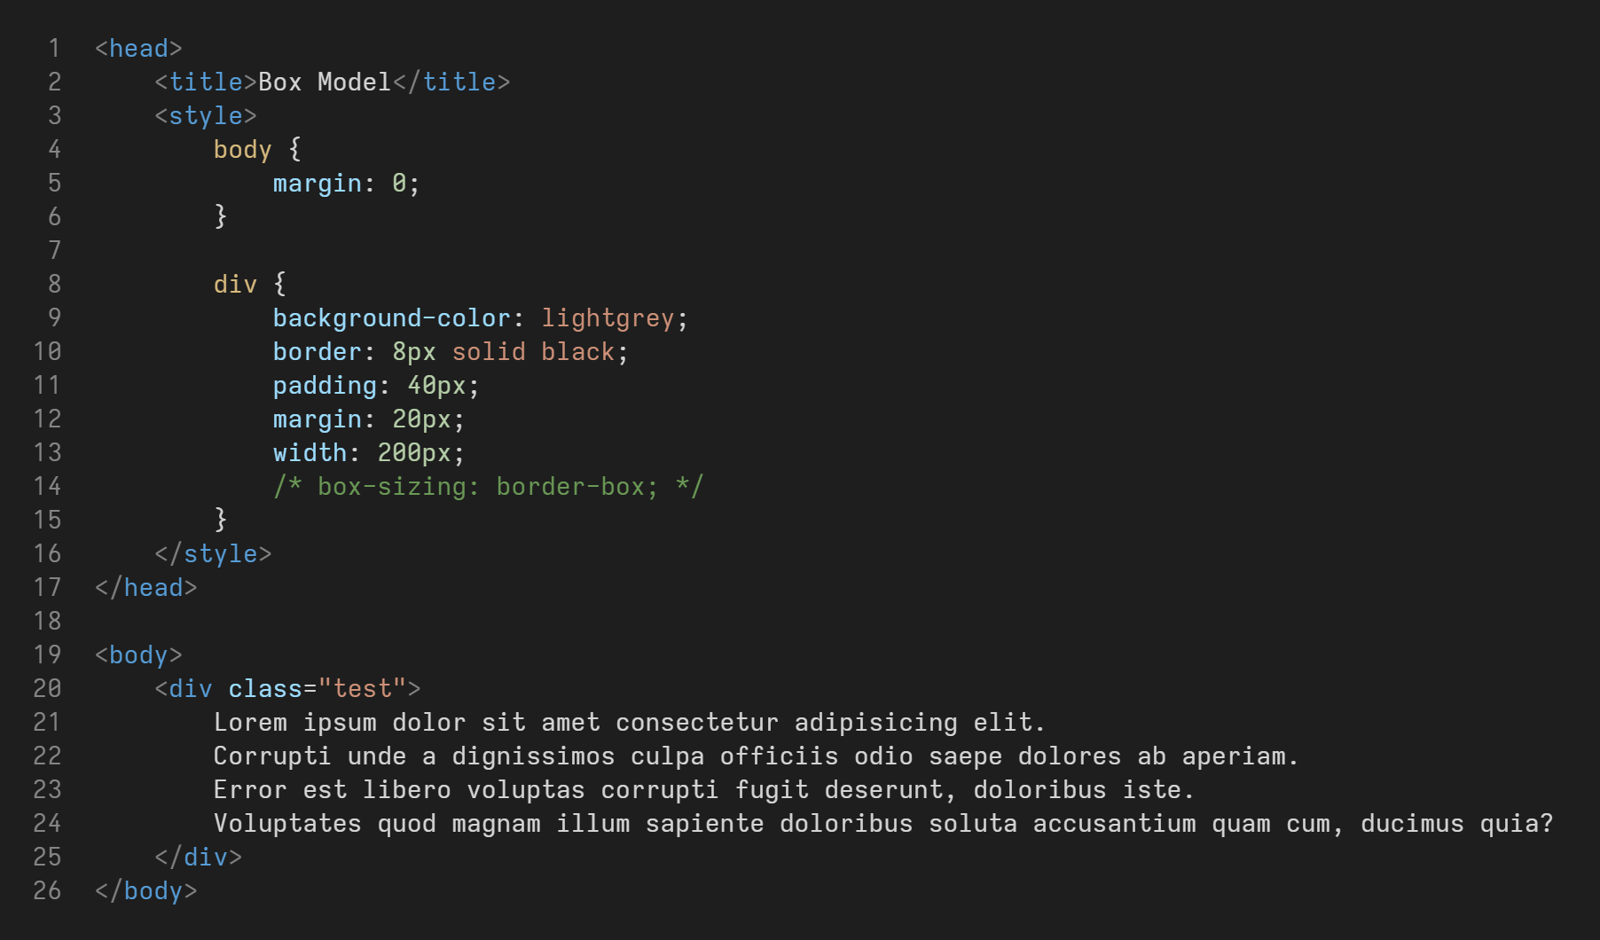
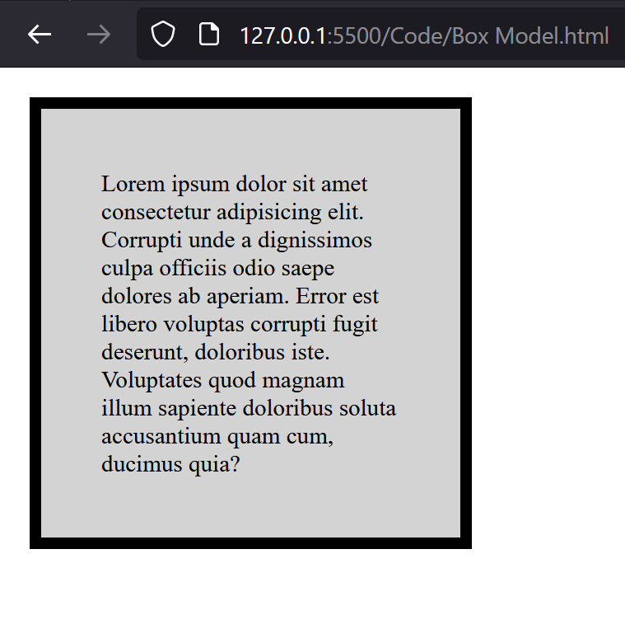
Box Model

Slide 46
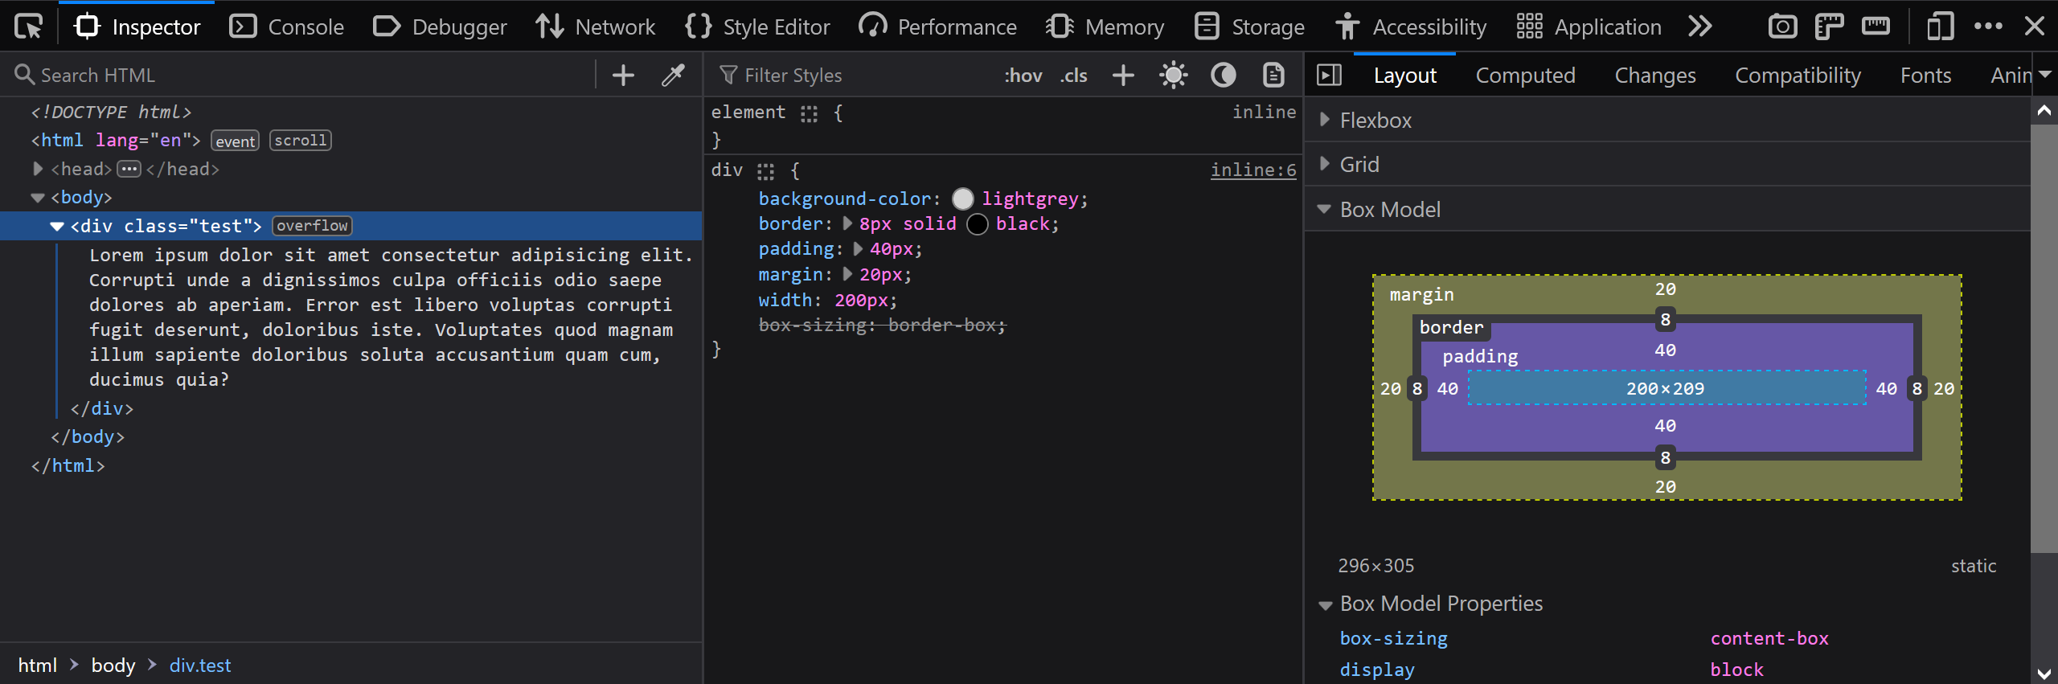
Box Model

Slide 47
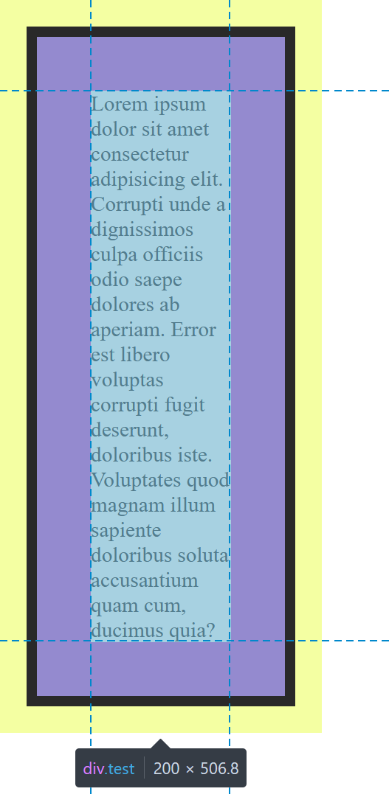
Box Sizing
box-sizing: border-box;
The width and height properties set the content box size by default.
This means that padding and border add to the overall size of the box.
Usually we want to set the width and height of the whole box.
This means that the default box-sizing of content-box is not wanted.
Both boxes have a width of 200px.
Left box: the content-box is 200px which has padding and border added to it making the box 296px. 200px (content) + 40px + 40px (left/right padding) + 8px + 8px (left/right border)
Right box: the border-box is 200px which means the content is lowered (104px) so when the padding and border thickness is added, the whole box is 200px.
104px (content) + 80px (padding) + 16px (border)
box-sizing: content-box;

Slide 48
Padding
Padding is a shorthand property:
padding: padding-top padding-right padding-bottom padding-left
The 4 properties set the padding for each side.
The complete shorthand form takes all 4 properties in a clockwise direction from the top.
padding: 1px 2px 3px 4px;
There are also shorter forms:
padding: 2px; /* sets 2px for all 4 sides */
padding: 2px 4px; /* sets 2px top & bottom, 4px for left & right */
padding: 2px 3px 4px; /* sets 2px for top, 3px for left & right, 4px for bottom */
padding: 1px 2px 3px 4px; /* sets each side separately */

Slide 49
Margin
The margin property is almost the same as padding and the takes such values:
margin: 2px; /* sets 2px for all 4 sides */
margin: 2px 4px; /* sets 2px top & bottom, 4px for left & right */
margin-top: 3px; /* sets 3px for top */

Slide 50
Border
Border is a shorthand property.
border: border-width border-style border-color
border-width is any acceptable length unit.
border-style can be solid, dotted, dashed, double, ...
border-color is any color value (name, rgb, hex, hsl)
border: 2px solid blue;
To set border for specific sides or different borders for each side, the longhand properties should be used.
For example, border-width-left.

Slide 51
Thank you for your attention.

